Slide 1
Name
Professor
Institution
Course
Date

Slide 2
Introduction
In “The catcher in the eye” Salinger introduces an overwhelming desire to retain childhood innocence
In the novel “Catcher in The Rye” we are introduced to Holden who explains about the days he entered mental institution.
He appears to be increasingly depressed after being expelled from school.
As Salinger explains, Holden reveals some bits of his life and mentions the death of Allie is young brother.
Throughout the Novel, we find discomfort in Holden following his attempts and fails to connect with his friends.
Based on the narration, Holden’s actions and thoughts appears confusing and this give a sense that he is facing underlying mental issues in need to be treated.
The novel reveals situations and kind of suffering that Holdens went through.
Holden suffered severe mental illnesses such as
The post-traumatic stress disorder (PTSD)
anxiety
Depression
There are depressive and Post traumatic conditions experienced by Holden that requires a couple of services in helping him lead a better life.
Notes:
In his Novel, “The catcher in the eye” Salinger introduces the readers to the overwhelming desire in retention of childhood innocence through Holden Caufield who is the main character in the story. The novel reveals situations and kind of suffering that Holdens went through. As suggested in the Novel, Holden suffered severe mental illnesses such as anxiety, depression and the post-traumatic stress disorder (PTSD) as evident nation throughout the entire story

Slide 3
Several suggestions and services to help Holden control stress
A couple of instances in the novel are addressed in the Novel
We find instances where Holden faced worst situation and stressful conditions.
There are several suggestions and services to help Holden encounter stressful
The services are
Canadian mental Health Association services
Big Brothers Big Sisters of Barrie and District services
the Canadian Mental Health Association Mental Health and Addiction Services
Catulpa community support services
Notes:
Due to the depressive and Post traumatic conditions experienced by Holden a couple of services are essential in helping him lead a better life. This paper, will address a couple of instances in the novel where Holden faced worst situation and offer best suggestions for to encounter his stressful conditions.

Slide 4

Catulpa Community Support Services
Holden requires the catalpa community support services
This service is located at Ferries Ln Barrie Canada
The service is known for offering treatment for youths
The service helps youth with autism disorder and it could also help Holden control stress.
In chapter one, the Salinger describes how Holden faced difficulty in social interaction.
Notes:
Based on the description and moments faced by Holden I believe that he requires the Catulpa Community Support Services . This service is located at Ferries Ln Barrie Canada and it is well known for offering treatment network for youths of Simcoe York. Besides, it has been helpful children and youths with autism disorder and it could also help Holden control stress. In chapter one, the Salinger describes how Holden faced difficulty in social interaction.

Slide 5
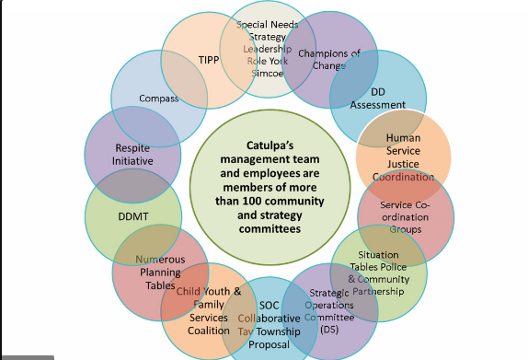
Continuation of Catulpa Community Support Services…
We learn that Holden tries to isolate from his friends
We find Holdens isolating himself from others as they watch game.
Holden find is difficult to socially interact with others.
He chooses to watch game on top of Thomsen Hill.
Holdens watches people and game rather than connecting with others.
Based on the above textual evidence, Holden has disorder related to social interaction
Notes:
We learn that Holden tries as much as possible to isolate from his friends. There is a moment in the novel where we find Holdens isolating himself from others as they watch. “I remember around 3 o’clock that afternoon, I was standing way the hell up on top of Thomsen Hill”. This is a clear indication that, Holden find is difficult to socially interact with others. He chooses to watch game on top of Thomsen Hill. Surprisingly, Holdens watches people and game rather than connecting with others. Based on the above textual evidence, Holden can be said to have disorder related to social interaction mostly probably Autism spectrum Disorder

Slide 6


The Big Brothers Big sister of Barrie and District service
Holden in adversity situation where he tries to call somebody while in New York
All of a sudden, he changes his mind.
He faces a scary situation and feels alienated from friend.
The Big Brothers Big sister of Barrie and District service is best service for him
Can use this sercice to handle and control stress related to mental health problem.
Notes:
As evident in chapter 9 we find Holden in adversity situation where he tries to call somebody while in New York but all of a sudden, he changes his mind. He faces a scary situation and feels alienated from friend. The Big Brothers Big sister of Barrie and District services best service for him to handle and control stress related to mental health problem.

Slide 7
Continuation Big Brothers Big sister of Barrie and District service…
This service is located at Bayfiled St, Barrie Canada.
It offers programs for youths like Holden to handle and manage stress
This services helps mental health people in making healthy decisions
It can be useful in building good relationships with peers and his family.
Notes:
The Big Brothers Big sister of Barrie and District service service is located at Bayfiled St, Barrie Canada. It provides programs for youths like Holden to talk and share their growing up experience with role model. This will also help him make healthy decisions and build good relationships with peers and his family.

Slide 8

The Canadian Mental Health Association and addictive service
The Canadian Mental Health Association and addictive is a service located at Anne St S
Barrie.
It promotes mental health
It is also a service that is useful for Holden’s mental illness.
In chapter 20 Holden finds himself in a situation that he tries to reach his friend but faces shut down.
Notes:
The Canadian Mental Health Association and addictive service is a service located at Anne St S
Barrie. This Service promotes mental health is also a service that is useful for Holden’s mental illness. In chapter 20 Holden finds himself in a situation that he tries to reach his friend but faces shut down. “I guess it was because I was feeling so damn lonesome”.

Slide 9

Continuation The Canadian Mental Health Association and addictive service…
Holden needs The Canadian Mental Health Association and addictive services
The service can help him promote his mental health.
It also offers gifts for those individuals with mental health
It is beset for youth out treatment programs for mental Health.
Service can control his stress through community education programs.
Notes:
This is situation that he needed Canadian Mental Health Association service to promote his mental health. This service is best to control his stress through community education programs. The service consists of Annual Christmas Gift Campaign and is the best for Holden as it offers gifts for those individuals with mental health and youth out treatment programs for mental Health.

Slide 10

Canadian Mental Health Association Services
I believe that Canadian Mental Health Association Services is the best service to help Holden deal with stressful and mental health problems.
This service is located at North Grey.
In the novel the author offers an account of nature of Holden’s mental Health.
He describes Health mental by referring to Holden.
Notes:
I believe that Canadian Mental Health Association Services is the best service to help Holden deal with stressful and mental health problems. This service is located at North Grey. In the novel the author offers an account of nature of Holden’s mental Health. He describes Health mental by referring to Holden.

Slide 11
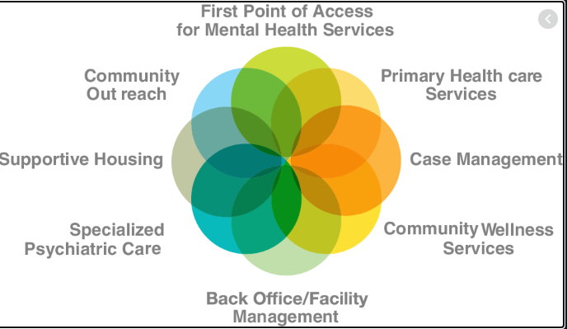
Continuation Canadian Mental Health Association Services…
He attributes unhappiness experienced by Holden to mental Disorder.
Services offers primary health care
It is First point of mental healthcare services
It is also clear that Holden is depressed though appears to live a fortunate life.
The death of his brother and sister as well as the classmate’s death witness scene could have led to this mental health problem
Notes:
He attributes unhappiness experienced by Holden to mental Disorder. It is also clear that Holden is depressed though appears to live a fortunate life. The death of his brother and sister as well as the classmate’s death witness scene could have led to this mental health problem

Slide 12
Conclusion
To sum up, Holden is having a mental illness and has brought about stress and many frustrations in life, such as failing in school and having difficulty interacting with people
The Novel portrays how Holden, the main character desired to retain innocence during childhood.
Through reading, the author reveals happiness and misery faced by Holden and he expresses fear in social interaction.
is an indication that, he is likely having mental illness that need services available in Simcoe County.
The solution to his situation can be solved by accessing the Simcoe County services like the
Canadian mental Health Association
Big Brothers Sisters of Barrie and District
Canadian Mental Health Association Mental Health and Addiction Services,
catalpa community support service
All these services offer mentorship and promote mental Health for people experiencing mental illness like Holden.
Notes:
To sum up, Holden is having a mental illness and has brought about stress and many frustrations in life, such as failing in school and having difficulty interacting with people. To sum up, the novel “The Catcher in the Rye” portrays how Holden, the main character desired to retain innocence during childhood. Through reading, the author reveals happiness and misery faced by Holden and he expresses fear in social interaction. This is an indication that, he is likely having mental illness that need services available in Simcoe County. The solution to his situation can be solved by accessing the Simcoe County services like Canadian mental Health Association
Big Brothers Sisters of Barrie and District
Canadian Mental Health Association Mental Health and Addiction Services,
catalpa community support service
The services offer mentorship and promote mental Health for people experiencing mental illness like Holden.

Slide 13
Work cited
https://barrie.bigbrothersbigsisters.ca/
https://cmhastarttalking.ca/
www.catulpa.on.ca
www.cmhastarttalking.ca

